Slide 1
Viral Interference
When a virus-infected cell resists superinfection with the same or a different virus or virus-virus interaction in which the infection and/or replication of one virus is altered by the presence of another virus within the same host
HOW?
(1) interference mediated by defective interfering mutants, operating only against the homologuous virus , and
(2) interference mediated by interferon

Slide 2
INTERFERONS
Discovery by Isaacs and Lindenmann in 1957.
Interferon is so named because of its ability to interfere with virus reproduction or replication
Interferons (IFNs) are low molecular weight proteins made and released by lymphocytes in response to the presence of pathogens—such as viruses, bacteria, or parasites—or tumor cells.
They allow communication between cells to trigger the protective defences of the immune system that eradicate pathogens or tumors.

Slide 3
Types of IFNs
Three main classes- type I IFNs, type II IFN and type III IFNs.
The two main type I IFNs includes IFN-α (further classified into 13 different subtypes such as IFN-α1, -α2, -α4, -α5, -α6, -α7, -α8, -α10, -α13, -α14, -α16, -α17 and -α21), and IFN-β.
The type II IFN family consists of just IFN-γ.
The type III IFN family comprises IFN-λ subtypes with similar functions to type I IFN cytokines but restricted activity because their receptor is restricted to epithelial cell surfaces.

Slide 4
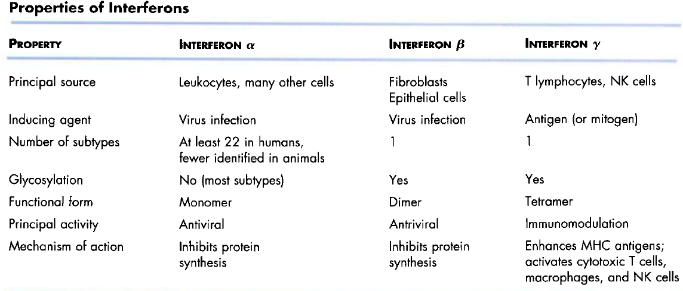

Slide 5
Being cytokines, IFNs have other functions:
1.They activate immune cells, such as natural killer cells & macrophages;
2.They increase recognition of infection or tumor cells by up-regulating antigen presentation to T- lymphocytes;
3. They increase the ability of uninfected host cells to resist new infection by virus.
Interferon itself is not directly the anti-viral agent, but it is the inducer of one or many anti-viral mechanisms

Slide 6
Activities of interferon
Antiviral actions
initiate an antiviral state in cells
block viral protein synthesis
inhibit cell growth
Immunomodulatory actions
IFN alpha and IFN-beta activate NK cells
IFN alpha and gamma activates macrophages
increase MHC antigen expression
regulate the activities of T cells
Other actions
regulate inflammatory processes
regulate tumor growth

Slide 7
Interferon inducing agents
(1) Viruses.
(2) dsRNA is a potent inducer, both viral intermediates, and synthetic poly-C.
(3) Certain Bacterial infections, and the production of endotoxin.
(4) Metabolic activators/inhibitors.

Slide 8
Mechanism of action
IFN release from an initially infected cell occurs
IFN binds to a specific cell surface receptor on plasma membrane of other cells- one receptor for interferons α and β and another for interferon γ.
IFN induces the “antiviral state” : synthesis of protein kinase, 2’5’ oligoadenylate synthetase, and ribonuclease L
Viral infection of the cell activates these enzymes
Inhibition of viral and cellular protein synthesis occurs.

Slide 9
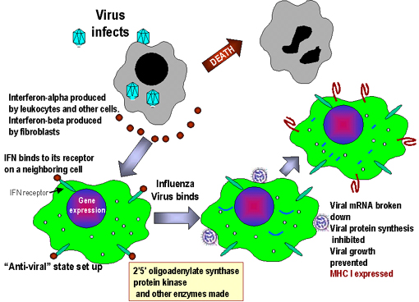

Slide 10
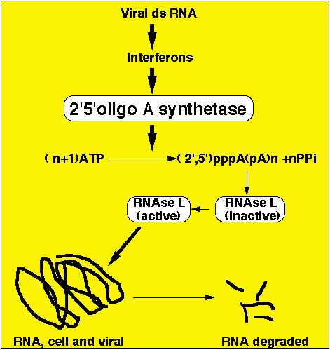

Slide 11
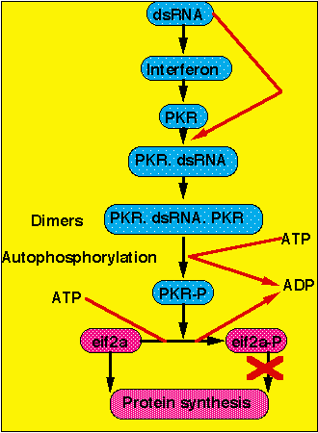
protein kinase RNA dependent

Slide 12
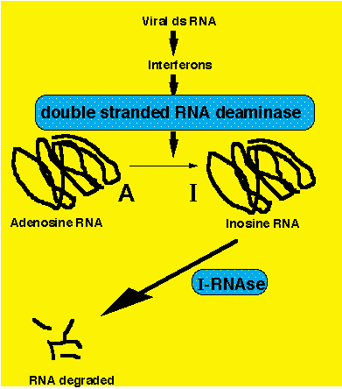

Slide 13
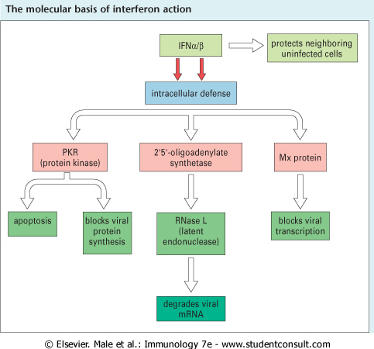
Virus-infected cells
= resistant status
of uninfected cells
Increase expression of MHC class I and II, and thus antigen presentation
Killing signal for CTLs
Bcl-2 and caspase cascade
eIF-2
Blocks translation
Notes:
Mx protein –myxovirus resistance

Slide 14
Viral Pathogenesis
Viral pathogenesis describes the processes by which viral infections cause diseases and involves virus–host interactions at the cellular and systemic level that determine whether a virus will cause a disease, what form that disease takes, and how severe the disease will be.

Slide 15
Tropism - The spectrum of tissues infected by a virus is called tropism.
For example, an enterotropic virus replicates in the gut, whereas a neurotropic virus replicates in cells of the nervous system.
Some viruses are pantropic, infecting and replicating in many cell types and tissues.
Tropism is governed by at least four parameters.
by the distribution of receptors for entry (susceptibility), or
by a requirement of the virus for differentially expressed intracellular gene products to complete the infection (permissivity).

Slide 16
However, even if the cell is permissive and susceptible, infection may not occur because the virus is physically prevented from interacting with the tissue (accessibility).
Rhinoviruses multiply exclusively in the upper respiratory tract because they are adapted to multiply best at low temperature and pH and high oxygen tension.
Finally, an infection may not occur even when the tissue is accessible and the cells are susceptible and permissive because of the local intrinsic and innate immune defenses.
Even if virus initiates infection in a susceptible organ, replication of sufficient virus to cause disease may be prevented by host defenses.

Slide 17
Disease occurs only if the virus replicates sufficiently to damage essential cells directly, to cause the release of toxic substances from infected tissues, to damage cellular genes or to damage organ function indirectly as a result of the host immune response to the presence of virus antigens.
Pathogenesis at the cellular level occurs in progressive stages leading to cellular disease.
Since viruses must use the cell's machinery to synthesize their own nucleic acids and proteins, they have evolved various mechanisms to subvert the cell's normal functions to those required for production of viral macromolecules and eventually viral progeny.

Slide 18
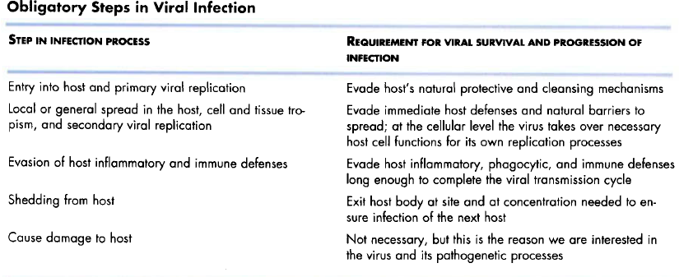

Slide 19
Viral Pathogenesis
Pathogenic mechanisms of viral disease include
(1) implantation of virus at the portal of entry,
(2) local replication,
(3) spread to target organs (disease sites), and
(4) spread to sites of shedding of virus into the environment.
Factors that affect pathogenic mechanisms:
(1) accessibility of virus to tissue,
(2) cell susceptibility to virus multiplication, and
(3) virus susceptibility to host defenses.

Slide 20
Entry Points for a virus into a host
Viral Entry -Three requirements must be satisfied to ensure successful infection in an individual host:
• Sufficient virus must be available to initiate infection
• Cells at the site of infection must be accessible, susceptible, and permissive for the virus
• Local host anti-viral defense systems must be absent or initially ineffective.
Routes of Entry
1. Skin - poxviruses, togaviruses, flaviviruses, rhabdoviruses
By injury
Mechanical transfer by arthropod vectors -arboviruses
Piercing through skin- iatrogenic
Animal bites

Slide 21
2. Respiratory Tract - herpesviruses, adenoviruses, myxoviruses, paramyxoviruses, rhinoviruses
Through droplets or fomites
Spread via coughing and sneezing
Environmental and physicochemical properties of virus particles influence virus survival in aerosol
3. Gastrointestinal Tract - picornaviruses, rotaviruses, coronaviruses, parvoviruses, caliciviruses, astroviruses, adenoviruses.
By contaminated food and water

Slide 22
4. Genitourinary Tract - retroviruses, herpesviruses, papillomaviruses.
Due to trauma or abrasions to epithelium
Infections of epithelium
5. Conjunctiva - adenoviruses, herpesviruses
Usually leads to conjunctivitis
Sometimes may lead to systemic infection, e.g. Infectious canine hepatitis virus
Viremia - presence of infectious virus particles in the blood. These virions may be free in the blood or contained within infected cells such as lymphocytes.

Slide 23
Virus dissemination within the host
An infection that spreads beyond the primary site of infection is called disseminated.
1. Localized versus systemic infection:
Infection of polarized epithelial cells
If virus is budding at the luminal surface- the disease is localized
If the virus is released at the basal surface- systemic infection is a strong possibility
2. Hematogenous spread. Occurs through:
The bite of an arthropod vector
Iatrogenic inoculation
Use of contaminated needles
Blood transfusion
Infections lead to viremia, then spread to other susceptible sites in body

Slide 24
3. Neural spread
A neurotropic virus can infect neural cells; infection may occur by neural or hematogenous spread initiating from a peripheral site.
A neuroinvasive virus can enter the central nervous system (spinal cord and brain) after infection of a peripheral site.
A neurovirulent virus can cause disease of nervous tissue, manifested by neurological symptoms and often death.

Slide 25
Examples:
Herpes simplex virus has low neuroinvasiveness of the central nervous system, but high neurovirulence. It always enters the peripheral nervous system but rarely enters the central nervous system. When it does, the consequences are almost always severe, if not fatal.
Mumps virus has high neuroinvasiveness but low neurovirulence. Most infections lead to invasion of the central nervous system, but neurological disease is mild.
Rabies virus has high neuroinvasiveness and high neurovirulence. It readily infects the peripheral nervous system and spreads to the central nervous system with 100% lethality unless antiviral therapy is administered shortly after infection.

Slide 26
Incubation Period
The incubation period is the time between exposure to virus and onset of disease.
During this usually asymptomatic period, implantation, local multiplication, and spread (for disseminated infections) occur.
The incubation period tends to be brief (1 to 3 days) in infections in which virus travels only a short distance to reach the target organ (i.e., in infections in which disease is due to virus replication at the portal of entry).
Conversely, incubation periods in generalized infections are longer because of the stepwise fashion by which the virus moves through the body before reaching the target organs.

Slide 27
Multiplication in Target Organs
Virus replication in the target organ resembles replication at other body sites except that
the target organ in systemic infections is usually reached late during the stepwise progression of virus through the body, and
clinical disease originates there.
At each step of virus progression through the body, the local recovery mechanisms (local body defenses, including interferon, local inflammation, and local immunity) are activated.
Thus, when the target organ is infected, the previously infected sites may have reached various stages of recovery.
Depending on the balance between virus and host defenses, virus multiplication in the target organ may be sufficient to produce dysfunction manifested by disease or death.

Slide 28
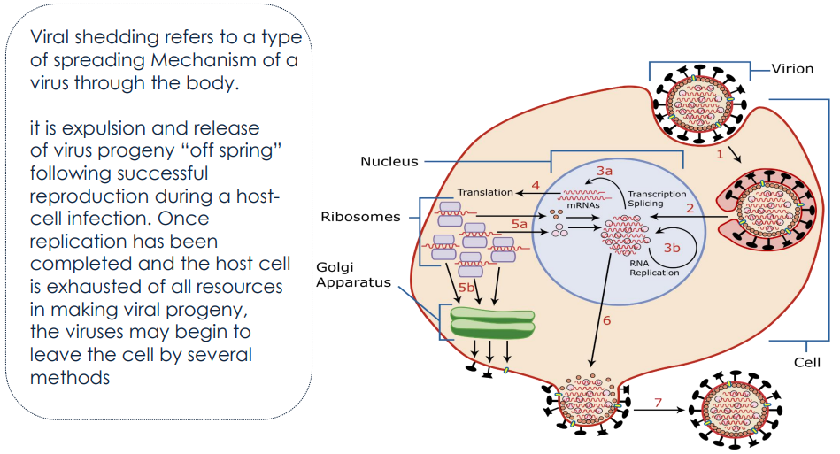
Virus shedding
Although the respiratory tract, alimentary tract, urogenital tract and blood are the most frequent sites of shedding, diverse viruses may be shed at virtually every site.

Slide 29
Virions can be released from the apical surface, from the basolateral surface, or from both.
After replication, virus released from the apical surface is outside the host. Such directional release facilitates the dispersal of many newly replicated enteric viruses in the feces (e.g., poliovirus).
In contrast, virus particles released from the basolateral surfaces of polarized epithelial cells have been moved away from the defenses of the lumenal surface.
Directional release is therefore a major determinant of the infection pattern.
In general, viruses released at apical membranes establish a localized or limited infection.
Release of viruses at the basal membrane provides access to the underlying tissues and may facilitate systemic spread.

Slide 30
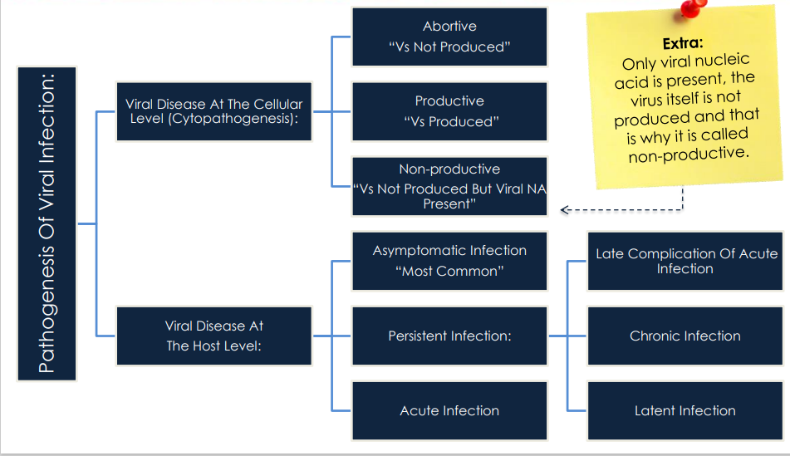

Slide 31
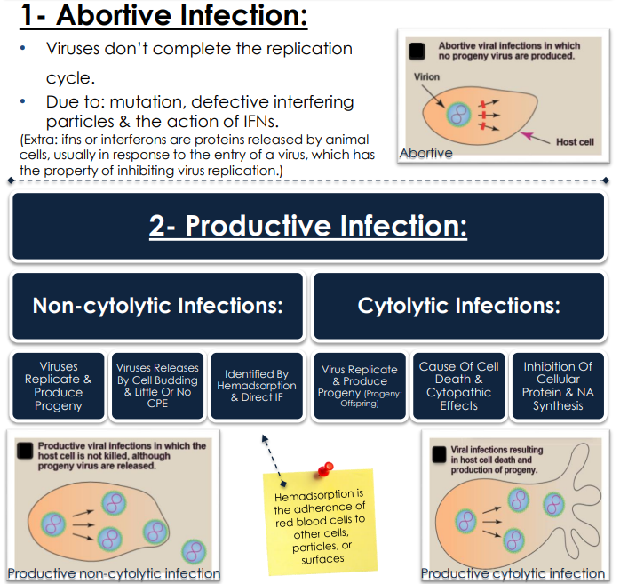

Slide 32
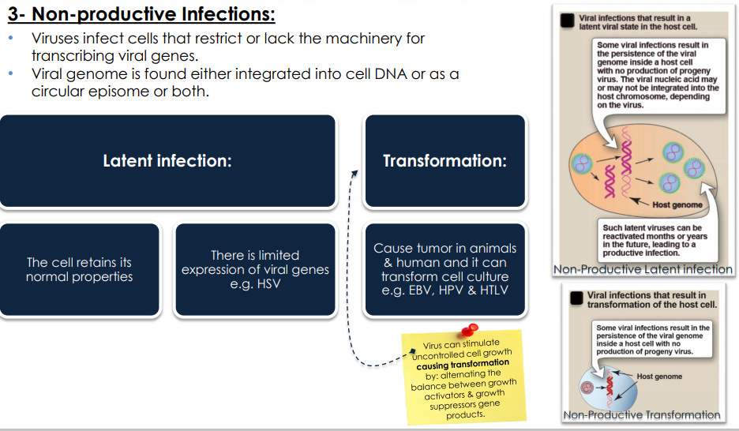

Slide 33
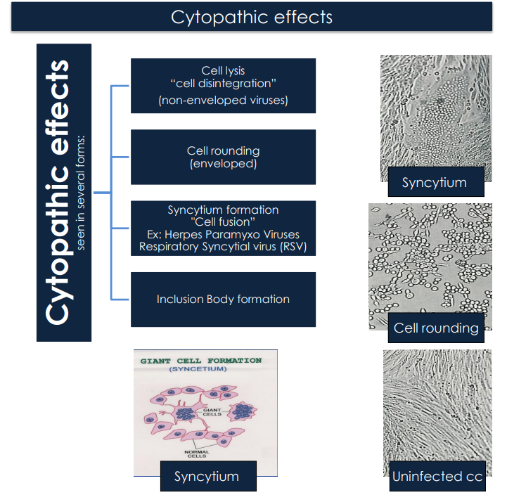

Slide 34
Genetic Determinants of Virulence
Gene products that alter the ability of the virus to replicate.
Gene products that modify the host’s defense mechanisms.
Genes that enable the virus to spread in the host
Toxic viral proteins

Slide 35
1. Gene products that alter the ability of the virus to replicate
Genes that encode proteins affecting both viral replication and virulence can be placed in one of two subclasses:
Mutation including a general defect in replication in the animal host and in many cultured cell types. Reduced virulence results from failure to produce sufficient numbers of virus particles to cause disease. Such a phenotype may be caused by mutations in any viral gene.
Mutation in a gene specifically required for virulence but no replication defects in cells in culture

Slide 36
2. Gene products that modify the host’s defense mechanisms
The study of viral virulence genes has identified a diverse array of viral proteins that sabotage the body’s intrinsic defenses and innate and adaptive systems.
Some of these viral proteins are called virokines (secreted proteins that mimic cytokines, growth factors, or similar extra-cellular immune regulators) or
viroceptors (homologs of cytokine receptors).
Mutations in genes encoding either class of protein affect virulence, but these genes are not required for growth in cell culture.
Most virokines and viroceptors have been discovered in the genomes of large DNA viruses.

Slide 37
Virokines
Virokines comprise a class of virus-coded proteins that are not required for viral replication in vitro, but influence the pathogenesis of infection in vivo by sabotaging the body's innate resistance or immune response.
Virokines can be grouped as
(1) inhibitors of T cell cytotoxicity that bind nascent class I MHC protein;
(2) inhibitors of cytokines, such as interleukin 1, interferon 2' and tumor necrosis-factor a;
(3) inhibitors of the complement cascade;
(4) inhibitors of antibody-mediated cytolysis; and
(5) cytokine mimics, e.g., interleukin 10.

Slide 38
3. Genes that enable the virus to spread in the host
The mutation of some viral genes disrupts spread from peripheral sites of inoculation to the organ where disease occurs.
For example, after intramuscular inoculation in mice, reovirus type 1 spreads to the central nervous system through the blood, while type 3 spreads by neural routes.
Studies of viral recombinants between types 1 and 3 indicate that the gene encoding the viral outer capsid protein s1, which recognizes the cell receptor, determines the route of spread.

Slide 39
4. Toxic viral proteins
Some viral gene products cause cell injury directly, and alterations in these genes reduces viral virulence.
Evidence of their intrinsic activity is usually obtained by adding purified proteins to cultured cells, or by synthesis of the proteins from plasmids or viral vectors.
The most convincing example of a viral protein with intrinsic toxicity relevant to the viral disease is the NSP4 protein of rotaviruses, which cause gastroenteritis and diarrhea.
NSP4 acts as a viral enterotoxin and triggers a signal transduction pathway in the intestinal mucosa.

Slide 40
Viral infections and Immunopathology
Most symptoms and many diseases caused by viral infection are a consequence of the immune response
Damage caused by the immune system is called immunopathology, and it may be the price paid by the host to eliminate a viral infection.
For non-cytolytic viruses it is likely that the immune response is the sole cause of disease.

Slide 41
Immunopathological Lesions
1. Lesions caused by cytotoxic T lymphocytes (CTLs)- eg Myocarditis caused by coxsackievirus B infection of mice requires the presence of CTLs.Acute and often fatal respiratory disease caused by hantaviruses is characterized by prominent infiltration of CTLs into the lung.
2. Lesions caused by CD4+ T-cells- CD4+ T lymphocytes elaborate far more cytokines than do CTLs and recruit and activate many nonspecific effector cells. Such inflammatory reactions are usually called delayed-type hypersensitivity responses.
Most of the recruited cells are neutrophils and mononuclear cells, which are protective and cause tissue damage.
Immunopathology is the result of release of proteolytic enzymes, reactive free radicals such as peroxide and nitric oxide, and cytokines such as TNF-α.

Slide 42
3. Immunopathological Lesions Caused by B-cells –
Virus-antibody complexes accumulate to high concentrations when extensive viral replication occurs at sites inaccessible to the immune system or continues in the presence of an inadequate immune response.
Such complexes are not efficiently cleared by the reticuloendothelial system and continue to circulate in the blood.
They become deposited in the smallest capillaries and cause lesions that are exacerbated when the complement system is activated.
Deposition of these immune complexes in blood vessels, kidney, and brain may result in vasculitis, glomerulonephritis, and mental confusion, respectively.
Antibodies may also enhance viral infection. This mechanism probably accounts for the pathogenesis of dengue hemorrhagic fever.

Slide 43
4. Injury Mediated by Free Radicals-
Nitric oxide (NO) is produced in virus-infected tissues during inflammation as part of the innate immune response.
This gas has been shown to inhibit the replication of many viruses in cultured cells and in animal models.
While low concentrations of NO have a protective effect, high concentrations or prolonged production have the potential to contribute to tissue damage.

